Slide 1
WJEC Level 1/2 Vocational Award
Engineering
Notes:
Welcome to this short presentation on why Engineering may be the course for you. We’re going to have a look at why this course may suit your interests, your way of thinking, or your future aspirations for further education or the start of a career. We’ll have quick look at what the course covers over the two years and where it could lead you.

Slide 2
WJEC
Engineering
Why Engineering?
Technical knowledge
Practical skills
Peer feedback
Problem solving
Regular deadlines
Preparation for careers in engineering
Notes:
So, why this course, why Engineering.
The world around us has be designed and made by engineers, from your phone, to your house and street, to aeroplanes, boats, bridges, fridges, any product has been made by an engineer.
This course is a brilliant introduction to how engineering companies work and how engineers go about solving real-world problems.
We cover a lot of theory covering the technical knowledge you’ll need to begin researching, designing and making.
We cover practical making skills from card models, to 3D printed prototypes, to turned and milled metal components with real-world uses.
You’ll receive peer and teacher feedback on your designs to collaboratively improve and develop your designs.
You’ll be given real problems to solve and have to research existing designs, to draw on what works and doesn’t.
You’ll have clear and regular deadlines to tick off chunks of the course as you go, reducing stress.
You’ll be preparing skills that you can actually use in the future.

Slide 3
Engineering
The Course
WJEC
The Course
Unit 1
Manufacturing Engineering Products
Unit 2
Designing Engineering Products
Unit 3
Practical and Written Exams
Grading
Level 2
Distinction*
Distinction
Merit
Pass
Level 1
Distinction*
Distinction
Merit
Pass
Notes:
The course is split across the two years into several parts called Units, at the end of each you’ll have a deadline with a hand in before being given time to improve based on teacher feedback.
These mimic real-world deadlines in the engineering world.
Unit 1 and 2 are classroom-based and lesson time is devoted to working through each task.
Unit 3 is the externally assessed unit which includes both a practical and written exam.
The Units are graded as either pass, merit or distinction, each with an equivalent GCSE level grade.

Slide 4
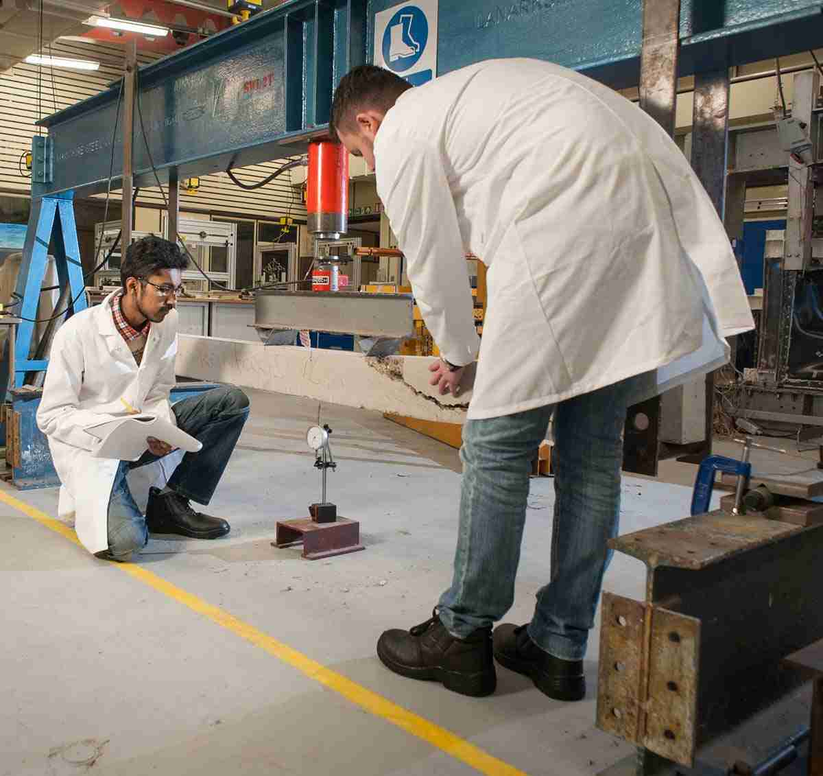
Engineering
Where could it take you?
WJEC
Engineering Apprenticeships
Product Design
Transport Design
Model Making
Architecture
Engineering
CNC Machinist
Manufacturing
The Armed Forces
Notes:
WJEC Engineering can prepare you for a whole host of different courses and jobs involving practical design and problem solving, from Engineering Apprenticeships to begin a career in engineering, to University course in engineering or other associated fields.

Slide 5
Engineering
WJEC
Consider Engineering
Notes:
So why not consider Engineering. If you’re a learner who appreciates regular deadlines, thrives on researching and developing ideas and making using a range of tools and equipment, then Engineering might just be for you.

